Slide 1


Weekly Drops
Initial Pulse Check
Kelly Peterson
Date: Dec 8 2023

Slide 2



Research approach
We completed 9, 20 min Cx interviews. All Cx recruited were…
Located in a Weekly Drops test market
In the Weekly Drops treatment group 2
Interacted with the Weekly Drops carousel
The goal of these calls were to…
Collect initial reactions to Weekly Drops
Scope awareness/recall of the offering
Identify areas of confusion or misunderstanding
Understand reasons why used or didn’t use Weekly Drops
Assess potential impact of weekly drops
The research brief can be found here.
You can watch the interview videos here
Notes:
James to link to failed session

Slide 3
Were Cx aware of weekly drops?

Slide 4
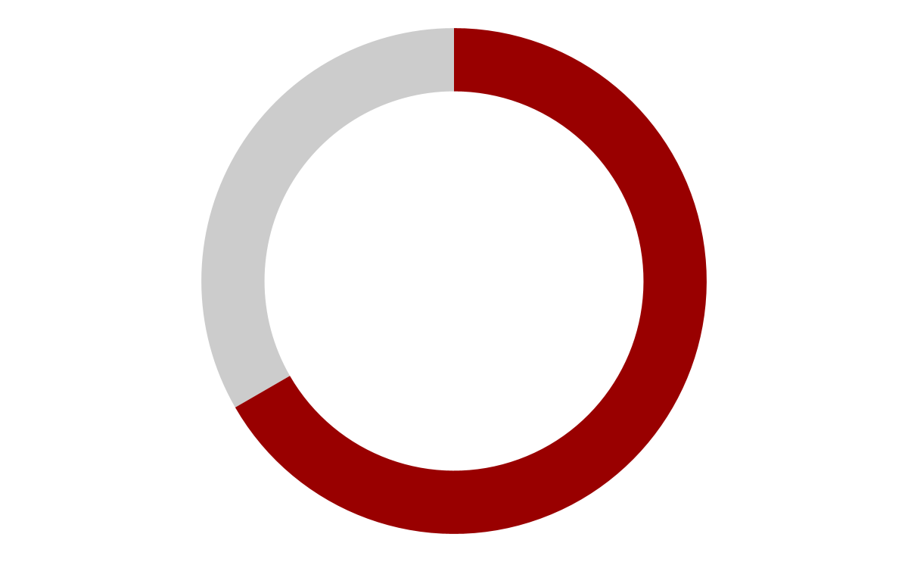


Product recall was strong with most Cx remembering a $0 delivery carousel
3 out of 6 converted Cx remembered completing at least one Weekly Drops purchase
6 out of 9 recalled Weekly Drops with limited prompting (unaided)
“Was there anything that you noticed recently in the app related to savings?” or “Did you notice any savings opportunities around delivery fees?”

Slide 5

Cx remember the discount, but not the timing/rotation
Most of the Cx we spoke to remembered seeing $0 delivery & a % off their order, and knew there was a minimum order amount. But it required referencing the app again to realize that it was a weekly refresh.

Slide 6






For some Cx, flashier savings or experiences were more top of mind or recalled first
“Something popped up on the screen about store rewards”
“I had a 40% off coupon I could use”
“There as 30% off my order”
“There are a lot of “holiday/black Friday” discounts
“There is now Happy Hour”
Cx were often draw to high % off their order, or to items that may have been prioritized in their home feed in that moment

Slide 7

For just a few Cx, Weekly Drops was not remembered at all
These Cx do not look on the homepage to find ways to save, they instead look to their preferred restaurants for savings. Instead they..
Go directly to and use the order again carousel to place an order
Use the search function to go to their Rx
There may be some additional work needed to ensure this experience is more memorable for Cx

Slide 8
How do Cx feel about Weekly Drops?

Slide 9


Almost Cx were happy with the selection available to them in Weekly Drops
Most Cx felt happy:
A good variety of Rx
A few places I have ordered from
A few places I am familiar with
A few places I would like to try
A few Cx had dislikes:
Too many chains, not enough local businesses
Irrelevant cuisines (e.g. bakeries)
Places I would not spend $12
There’s not that many in my area

Slide 10
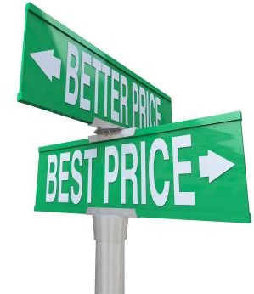
Most Cx felt Weekly drops helped to remove barriers to ordering
This is especially true when it comes to comparing to other apps
“I would probably compare like a couple of times and then once I saw, oh, this one's cheaper, then I'd probably just like go there first, you know what I mean?”
However, some Cx noted there are lot of other way they have found $0 delivery on the app so from them, this would only move the needle so much

Slide 11

DashPass is not one of the ways Cx look to experience $0 delivery
A few Cx mentioned they had previous trials of DashPass or that they had DashPass previously
For most of the these Cx, their financial situation had changed or was inconsistent so a subscription like DashPass was not worth it
For other, they were able to access DashPass through other ways like friends/family
While most Cx noted that these savings make it feel like they do not need DashPass, they were also not likely to sign up for DashPass in the first place

Slide 12
What else is needed to increase order frequency?

Slide 13
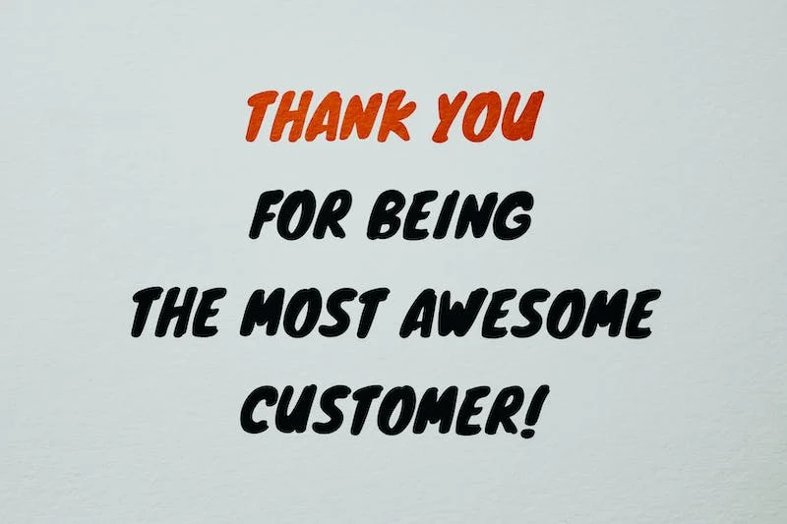
At the end of the day, Cx want to feel appreciated…
Every Cx we spoke to mentioned interest or motivation by some sort of spend and earn program
Cx felt strongly about this when they go through period where they order more frequently or order from the some Mx over and over
At the end of the day they want DoorDash to acknowledge their use of the app, and give back a few credits or give a higher discount

Slide 14

…and to get what they pay for
Almost every Cx we spoke to mentioned some sort of quality issue with DoorDash (missing items, waiting long for an order)
Experiences varied with CS where some felt their issue was alway resolved, and some felt they were not taken care of
Cx that order less frequently spoke of examples where they would order with 3 months in between their orders and CS was unable to support either issue
Other Cx noted quality issues as a reason for switching from other services; indicating the importance of these concerns
While our team does not cover quality, it is critical we are working with quality and CS when trying to resurrect Cx. If these Cx come back and experience issues with lackluster support, they will not increase ordering rates or loyalty to DoorDash

Slide 15
What can we do?

Slide 16
What if we….
Increase awareness/recall:
Ignore the idea of weekly, and instead focus on the time expiring/limited focus
Explore weekly drops vs. Expiring soon
Continue to infuse agency into onboarding experience
Explore different post checkout options to reinforce that savings are still there for them
Enhance the experience:
Infuse appreciation language into marketing materials
Continue to ensure that low inflation Mx are included in selection
Continue to ensure that Mx included can easily reach the minimum requirement
Continue to ensure a healthy mix of enterprise and SMB Mx in all markets
Explore opportunities to provide agency “bonuses” when Cx go through periods of ordering more frequently than usual or continually order from the same Rx
Work with teams to improve quality and explore VIP CS experience for occasional/habituating Cx

Slide 17

Next steps
After the launch of CRM in the new year we will run an online survey to quantify and deeper our understanding of Weekly Drops Cx.
Expected Sample:
N=400 Classic Cx who were in product treatment for Weekly Drops
Include a split of (target n=100 of each):
Cx who did not receive marketing
Cx who clicked on marketing but did not visit app
Cx who clicked on marketing & visited app
Cx who clicked on marketing & converted
Target 50/50 split of active vs. occasional/churned users
Follow up calls to be scheduled as needed
Research details & WIP Survey draft can be found here

Slide 18
Thank you!
Have a great holiday season, slow down & Happy New Year!

